Slide 1
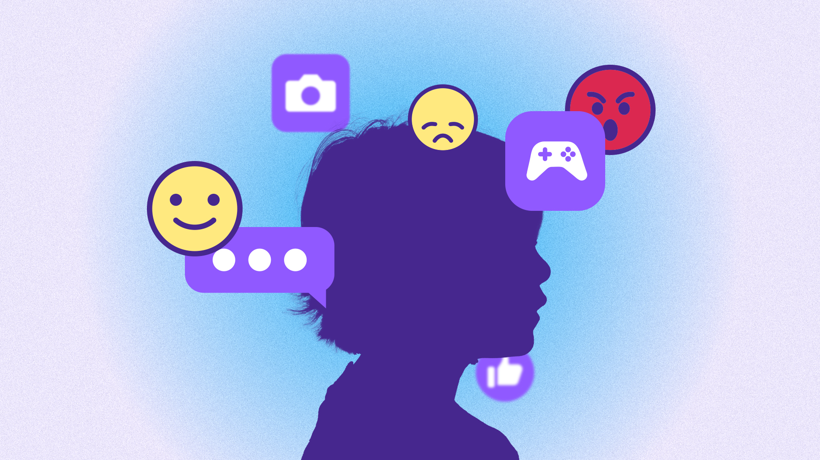

"How Emotions and Moods are Affected by Information Technology Use"
Notes:
Hello everyone,
I am Rucha Nilangekar, and I will be presenting on the topic "How emotions and moods are affected by information technology use"

Slide 2
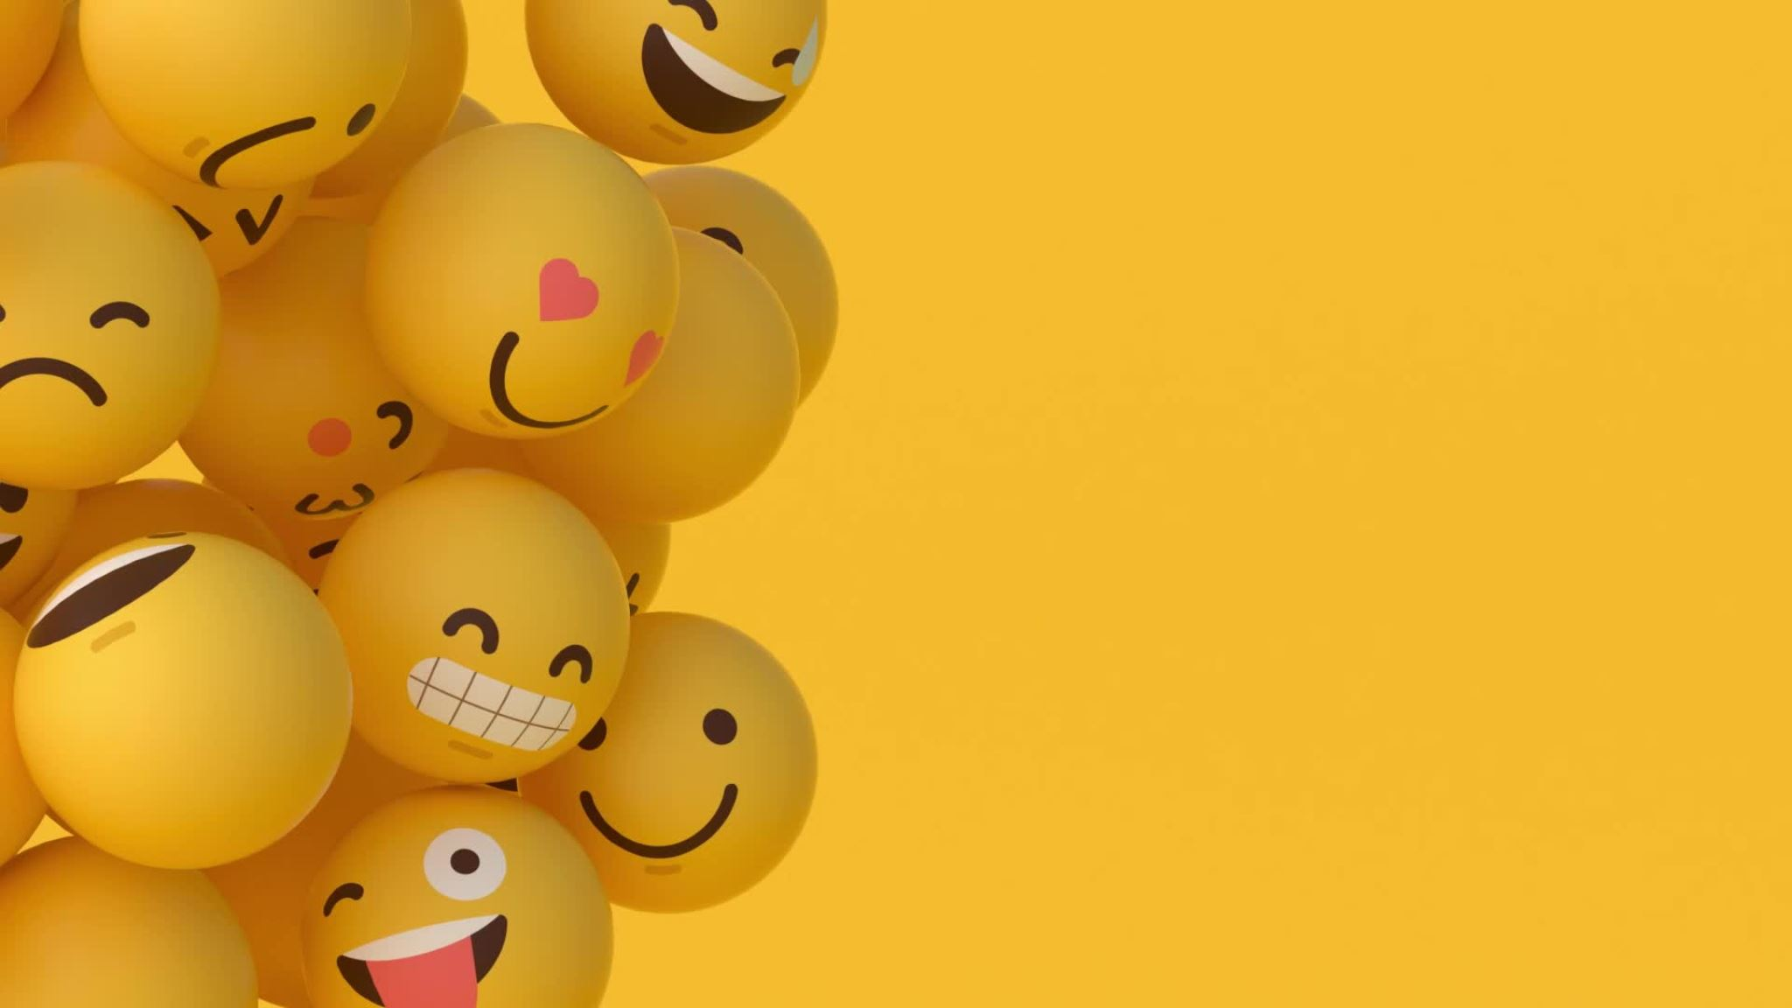
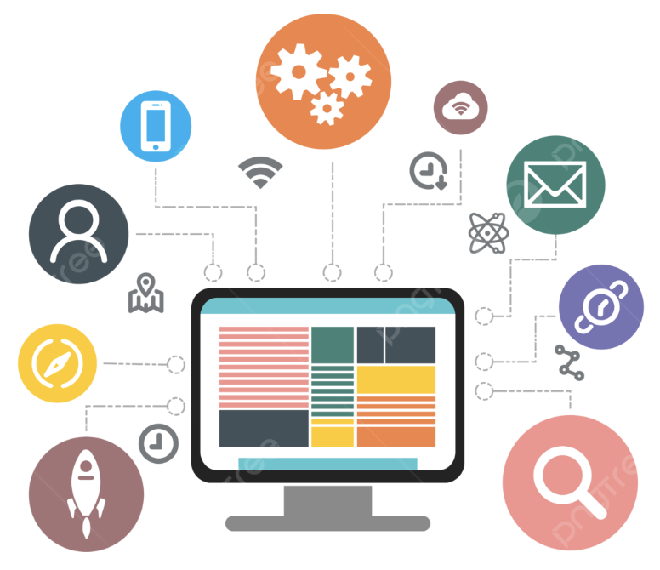
Terminology
Information Technology
Emotions
Moods
Notes:
To begin with lets understand some terminology. Information Technology. Information Technology includes a wide range of tools, systems, and devices that are designed to acquire, store, process, and communicate information.
Some of the examples of IT could be smartphones, laptops, social media platforms , cloud services as well as e- commerce websites.
---------------------------------------------------------------------------------------------------------------------------------------------------------------------------------------------
Emotions which originate as sensations in the body, are intense feelings (happiness, terror, despair) controlled by chemicals our brains release in response to a trigger or event. They almost always come and subside quickly. They also have corresponding and universal facial expressions and body language.
mood is a state of mind or a general feeling that can influence your thoughts, behaviors, and actions. Moods tend to be less intense than emotions and do not necessarily depend on an event or trigger. They can last for a few minutes, hours, or days.

Slide 3
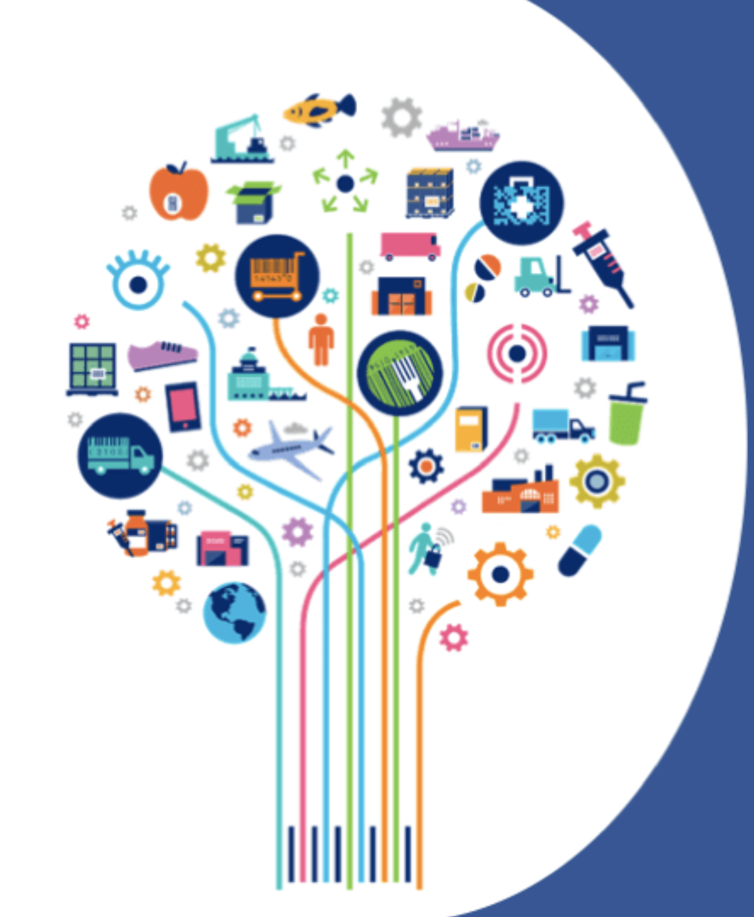
Prevalence of Information Technology
Health
Education
Grocery Shopping
Entertainment
Notes:
https://www.businessnewsdaily.com/4718-weekly-online-social-media-time.html
Furthermore, the average American spends five to six hours daily on their phone outside work requirements. Most Americans spend this phone time texting, using social media and browsing the internet.
https://www.pewresearch.org/internet/2021/09/01/the-internet-and-the-pandemic/
------------------------------------------------------------------------------------------------------------------------------------------------------
Now that we are familiar with the terminology , lets explore how IT, has dramatically transformed almost every area of our lives.
For eg
Health: fitness and health are now at our fingertips. Be it booking appointments with the doctor through teledoc or tracking health metrics through wearable devices or be it accessing workout routines online, we rely on technology for every thing.
Education: Education has become more flexible and accessible than ever. Online learning platforms and educational apps are empowering learners to expand their knowledge at their own comfort.
Grocery shopping- Regular chores like grocery shopping can now be done online . We can either opt for home delivery or curbside pickup, saving us time and effort.
Entertainment : streaming services like Netflix and YouTube provide endless entertainment options at our fingertips
------------------------------------------------------------------------------------------------------------------------------------------------
Another, example could be Reading: The way we read has also evolved. Physical books and newspapers have been supplemented by e-books, online news websites, and digital magazines. With IT, we have a vast library of reading material available instantly.
These are just some of the examples of how Information Technology has become an inseparable part of our daily lives, and its prevalence continues to shape the way we live, work, and interact with the world around us.
If time permits: Sure, here's a script for a presentation on how Information Technology (IT) has transformed daily tasks:
**Slide 2: Introduction**
*Script:*
Good morning, everyone. Today, we're going to explore how Information Technology, or IT, has dramatically transformed the way we go about our daily tasks. From communication to entertainment, IT plays a pivotal role in making our lives more convenient and efficient.
**Slide 3: Communication**
*Script:*
Let's start with communication. Not too long ago, sending a letter or making a phone call were our primary means of staying in touch. With the advent of IT, we now have instant messaging and video calls, making connecting with friends and family faster and more accessible.
**Slide 4: Navigation**
*Script:*
Navigating from one place to another used to involve paper maps or asking for directions. Now, with GPS technology and apps like Google Maps, finding your way has never been easier. IT has literally put the world in the palm of our hands.
**Slide 5: Grocery Shopping**
*Script:*
Grocery shopping is another area where IT has made a significant impact. Instead of visiting a store, we can now order groceries online through various apps and websites. They offer home delivery or curbside pickup, saving us time and effort.
**Slide 6: Banking**
*Script:*
Banking has become more accessible thanks to IT. Mobile banking apps allow us to check account balances, transfer money, pay bills, and even deposit checks—all from the convenience of our smartphones.
**Slide 7: Entertainment**
*Script:*
Entertainment has been transformed by IT. Remember the days of visiting video rental stores or waiting for a scheduled TV broadcast? Now, streaming services like Netflix and YouTube provide endless entertainment options at our fingertips.
**Slide 8: Reading**
*Script:*
The way we read has also evolved. Physical books and newspapers have been supplemented by e-books, online news websites, and digital magazines. With IT, we have a vast library of reading material available instantly.
**Slide 9: Time Management**
*Script:*
Managing our time has become more efficient thanks to IT. Tools like calendars, task management apps, and reminders help us organize our daily tasks. They ensure we don't miss important appointments or deadlines.
**Slide 10: Cooking and Recipes**
*Script:*
Cooking has also seen a digital transformation. Cooking apps and websites provide us with a treasure trove of recipes. They even create shopping lists and offer step-by-step cooking instructions, making meal preparation a breeze.
**Slide 11: Fitness and Health**
*Script:*
Our fitness and health are now at our fingertips. Wearable devices and fitness apps help us monitor physical activity, track health metrics, and access workout routines, making it easier to maintain a healthy lifestyle.
**Slide 12: Social Interactions**
*Script:*
Social interactions have transcended physical boundaries. Instead of only gathering in person, IT allows us to connect with friends and family through social media platforms and video chats, regardless of where we are.
**Slide 13: Education**
*Script:*
Education has become more flexible and accessible. Online learning platforms and educational apps offer a wide range of courses and resources, empowering learners to expand their knowledge.
**Slide 14: Weather Forecasting**
*Script:*
Planning your day used to depend on the weather forecast from a TV or radio broadcast. Now, IT provides real-time weather updates and forecasts, helping us make informed decisions and stay safe during extreme weather conditions.
**Slide 15: Conclusion**
*Script:*
In conclusion, Information Technology has permeated every aspect of our lives, making our daily tasks more convenient, efficient, and accessible. It has put the world at our fingertips, revolutionizing the way we live and work. As we continue to embrace IT, let's also consider how to balance our digital lifestyles for the betterment of our well-being.
Thank you for your attention.

Slide 4
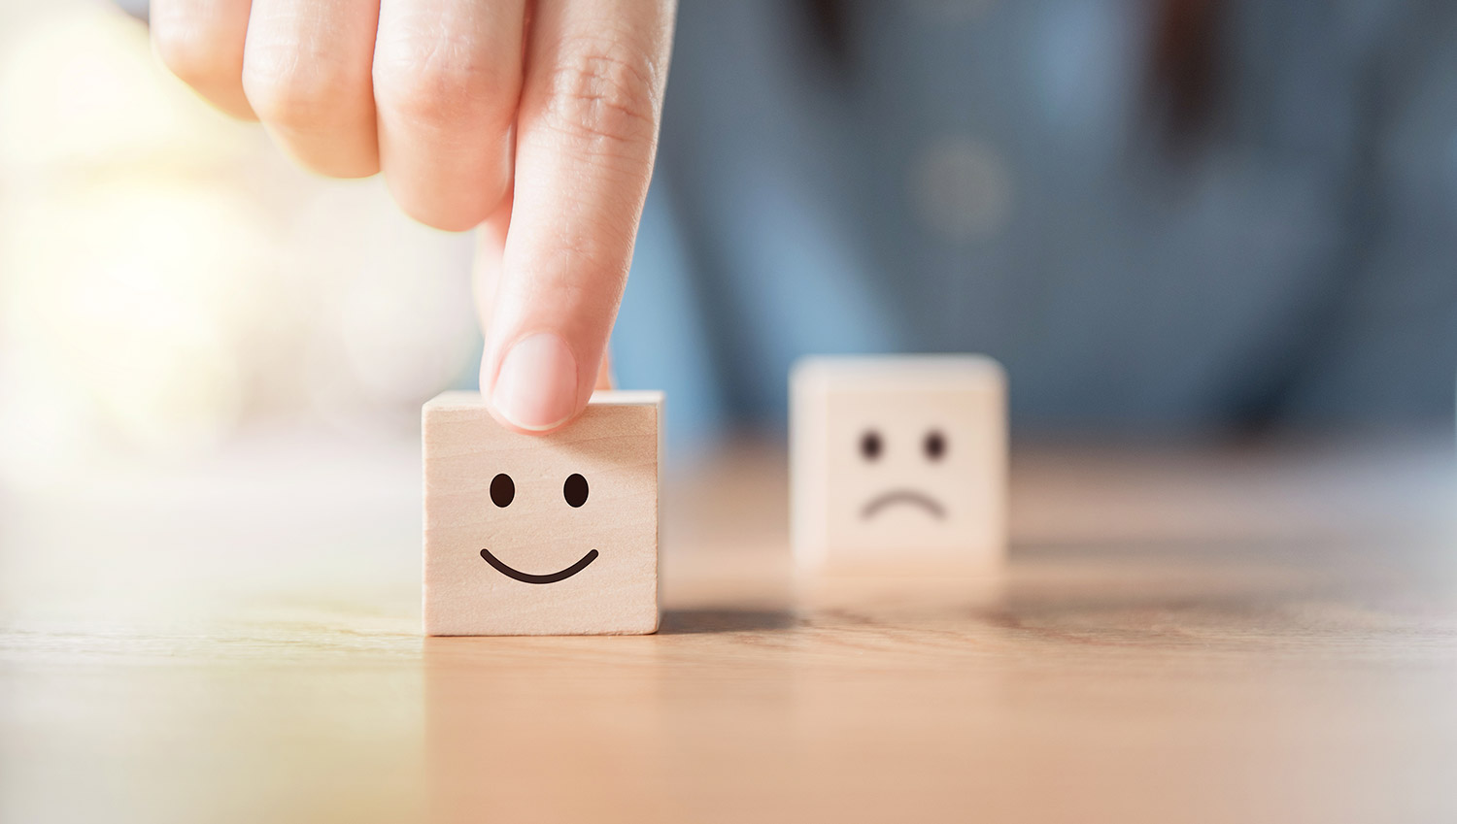
Positive Impacts on our Well Being
Strengthens emotional bonds
Increases Self-esteem
Motivation
Curiosity
Aids in Problem solving
Improves decision making
Notes:
Positive: https://www.linkedin.com/pulse/how-technology-has-changed-our-day-to-day-life-md-billal-hossain/
(Positive and Negative, along with how to avoid negative impacts)
https://www.forbes.com/sites/andrealoubier/2021/06/01/is-society-moving-in-the-right-direction-with-technology-rapidly-taking-over-the-world/?sh=376107a77c09
https://www.businessnewsdaily.com/4718-weekly-online-social-media-time.html
https://www.pewresearch.org/internet/2021/09/01/the-internet-and-the-pandemic/
1)sense of joy --- connectedness with loved ones
2)sense of Validation ---- due to recognition and appreciation on social media platforms
3)feeling of motivation when they watch or read about someone's journey of achieving their goals
4)Curiosity when a new gadget or technology is introduced.
5)Feeling of joy and relief in getting instant answers from AI chatbots or online communities
6)sense of independence for being able to plan trips without any assistance from travel agencies as all the info is available online
7)booking services online - making a decision based on the reviews
Script:
Moving forward, Lets dive into how IT influences our emotional state positively:
1. Connectedness with Loved Ones:
- In the digital age, technology facilitates and enhances our ability to connect with loved ones regardless of geographical distances.
2.
- Social media platforms provide a space for individuals to express themselves and receive recognition for their achievements, talents, and creativity, leading to a boost in self esteem.
3. Motivation:
- Access to stories of individuals overcoming challenges and achieving their goals through various media channels creates a sense of motivation among individuals.
4.Curiosity :
- The introduction of new gadgets and technologies fuels a sense of curiosity and wonder about the capabilities of technology.
5. Aids in Problem solving:
-, the AI chatbots and online communities help individuals in Troubleshooting tech issues
6. Improves decision making:
-Booking any kind of services online, is often influenced by the experiences shared by others. This practice provides a sense of confidence in decision-making, as individuals can leverage the collective wisdom of a digital community.
------------------------------------------------------------------------------------------------------------------------------------------------------------------------------------------------------------------------
- The availability of comprehensive travel information online empowers individuals to plan their trips independently, reducing reliance on traditional travel agencies. Access to user-generated reviews, detailed itineraries, and real-time updates on accommodations and attractions allows for personalized travel experiences. This sense of independence in trip planning contributes to a feeling of empowerment and the ability to tailor journeys to individual preferences.

Slide 5
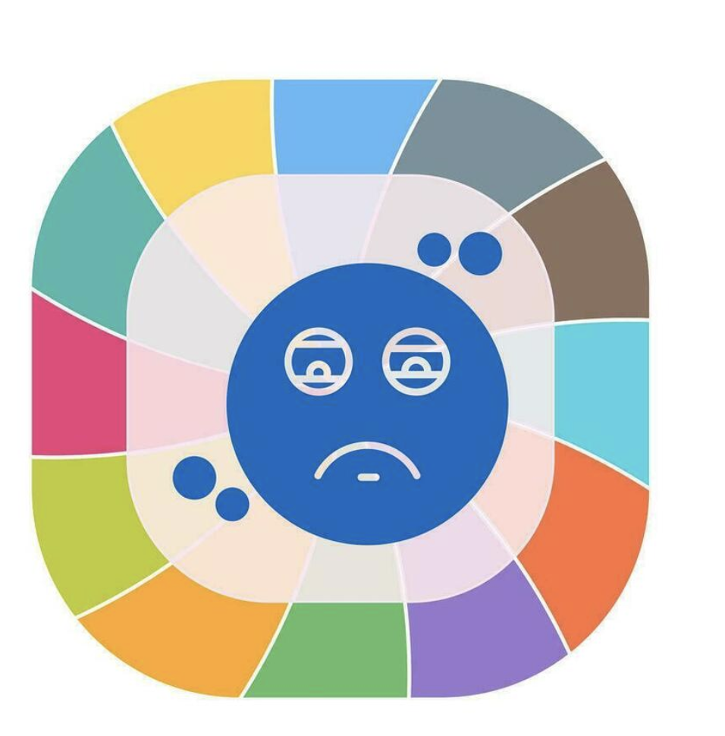
Negative Impacts On our Well Being
Technostress
Spike in physical and mental health issues
Decline in social skills
Fear of missing out (FOMO)
Increase in insecurities
Comparison leads to anxiety
Notes:
https://www.ncbi.nlm.nih.gov/pmc/articles/PMC6502424/
https://mydoctor.kaiserpermanente.org/mas/news/technostress-how-too-much-technology-effects-mental-health-2054999
https://www.medicalnewstoday.com/articles/negative-effects-of-technology#summary
Apart from the positives, technology has some negative impacts on our emotional state as well. In this slide lets discuss some of them.
1. Technostress:
Technostress refers to the psychological stress and discomfort that individuals may experience due to their use of technology. It can result from factors such as information overload, constant connectivity, and the rapid pace of technological change.
2. Spike in Health Issues:
Prolonged use of technology, can contribute to physical health issues such as eyestrain, headaches and an increased risk of obesity. Additionally, technology addiction can lead to mental health issues such as anxiety and depression.
3. Decline in Social Skills:
Heavy reliance on digital communication can lead to a decline in empathy impacting real-world relationships.
4. FOMO (Fear of Missing Out):
The fear of missing out on social events, experiences, or opportunities that others might be experiencing can evoke anxiety, insecurity, envy, and dissatisfaction among individuals.
5. Increase in Insecurities:
Social media, in particular, may contribute to body image insecurities as individuals compare their appearance to idealized standards.
----------------------------------------------------------------------------------------------------------------------------------------------------------------------------------------------------
6. **Comparison Leads to Anxiety:**
- *Social Media Influence:* The culture of comparison on social media platforms can contribute to heightened levels of anxiety. Individuals may feel pressure to meet unrealistic standards, leading to stress and a negative impact on mental health.
- *Perceived Expectations:* The constant exposure to curated images and achievements of others may create unrealistic expectations, causing anxiety about one's own life trajectory.
7. **Spike in Mental Health Issues:**
- *Technology and Mental Health:* The interplay between technostress, social comparison, and constant connectivity can contribute to a rise in mental health issues such as anxiety and depression.
- *Digital Burnout:* The demands of being constantly connected and the blurring of boundaries between work and personal life can contribute to digital burnout, impacting mental well-being.
In your presentation, you can elaborate on each of these points, providing examples and potential strategies to mitigate the negative effects. It's important to acknowledge the benefits of technology while also highlighting the importance of mindful and balanced use for overall well-being.

Slide 6
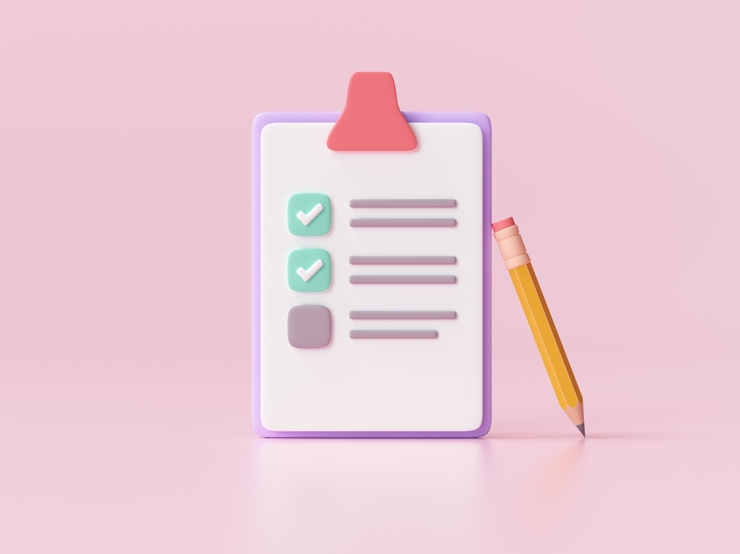
Case Study
Does Smartphone Use Drive our Emotions or vice versa? A Causal Analysis
https://www.jorgegoncalves.com/docs/chi20b.pdf
Notes:
https://www.ncbi.nlm.nih.gov/pmc/articles/PMC7366947/
https://www.floridatechonline.com/blog/psychology/how-smartphones-are-contributing-to-the-loneliness-epidemic/
https://explodingtopics.com/blog/screen-time-stats
https://www.ncbi.nlm.nih.gov/pmc/articles/PMC6502424/
https://www.lse.ac.uk/media-and-communications/assets/documents/research/working-paper-series/EWP33.pdf
https://greatergood.berkeley.edu/article/item/four_ways_technology_can_make_you_happier
https://srcd.onlinelibrary.wiley.com/doi/10.1111/cdev.12819
https://www.ncbi.nlm.nih.gov/pmc/articles/PMC9007765/
https://www.mckinsey.com/mhi/our-insights/gen-z-mental-health-the-impact-of-tech-and-social-media
https://www.jorgegoncalves.com/docs/chi20b.pdf
https://pursuit.unimelb.edu.au/articles/do-devices-help-us-regulate-our-emotions
Blue: phone use drives emotions; Orange: emotion drives phone use.
Next, lets look at a case study called “Does Smartphone Use Drive our Emotions or vice versa? A Causal Analysis” performed by a team at the University of Melbourne, in collaboration with Stanford and University College London. This research was conducted on 30 participants, with different demographic backgrounds with each participant having a standard 5 days work week.
The study introduces the concept of "digital emotion regulation," where activities like distraction, seeking alternative perspectives, or sharing emotions through technology contribute to emotional well-being.
----------------------------------------------------------------------------------------------------------------------------------------------------------
In response to the increased reliance on digital technologies during the COVID-19 lockdown, a research team at the University of Melbourne, in collaboration with Stanford and University College London, is exploring the complex relationship between technology use and emotional well-being. The research challenges the distinction between productive and unproductive technology use, suggesting that seemingly unproductive activities might serve as valuable forms of emotion regulation.
Emotions guide responses to challenges and opportunities, involving subjective feelings, physiological changes, expressive behaviors, and actions. Emotion regulation, the process of modifying emotions, can take various forms, including the use of digital technologies. The study introduces the concept of "digital emotion regulation," where activities like distraction, seeking alternative perspectives, or sharing emotions through technology contribute to emotional well-being.
The research tracked participants' experiences of emotion and their use of smartphone apps, revealing a mutual influence. While certain apps influenced emotions, emotions also led individuals to use specific apps. For example, sadness often led to the use of entertainment apps, indicating a coping mechanism. Understanding this relationship can enhance personalized digital wellness features and provide insights into why individuals turn to devices in challenging situations.
The study encourages reflection on how digital device use influences emotions, acknowledging the potential benefits of activities like social media engagement or playing games as forms of useful emotion regulation. While acknowledging existing technology-related challenges, the research suggests that certain digital activities contribute positively to emotional well-being, enhancing overall performance and social harmony.
In this research the team recruited 30 participants, with different demographic backgrounds. Participants were required to own an Android smart-phone to enroll in the experiment. Moreover, almost all participants had a standard 5 days work week with 2 days of weekend.
Picture 1:
The research team collected ~ 500K data points over 2 weeks of data collection process where application use was matched to corresponding emotion records.
The Figure A analyzed the count of applications launches per hour of a day, and as you could see the number of application launches grows towards the evening.
These results are inline with the Figure B where they visualized the average phone use duration per hour. And as you could see highest average duration of phone use occurs between 10pm and midnight while the lowest phone use occurs between 2:00 am and 7:00 am.
Picture 2:
Researchers then analyzed the fluctuations of the participants emotion through the week. We can see that towards the weekend participants’ joy increases, while on weekdays it drops; whereas sadness drops towards the weekend and is at its peak on weekdays.
Picture 3:
Shows the bidirectional causal relationship between the number of app launches and emotional state of the user to see if applications launches lead participants to experience certain emotions, and/or vice-versa. Blue: phone use drives emotions; Orange: emotion drives phone use.
In Picture 4:
They studied the causality between emotions and duration of different application categories. Blue: phone use drives emotions; Orange: emotion drives phone use. For eg. contempt drives use of communication apps for most participants.
------------------------------------------------------------------------------------------------------------------------------------------------------------
In this research the team recruited 30 participants, with different demographic backgrounds. Participants were required to own an Android smart-phone to enroll in the experiment. Moreover, almost all participants had a standard 5 days work week with 2 days of weekend.
Picture 1:
The research team collected ~ 500K data points over 2 weeks of data collection process where application use was matched to corresponding emotion records.
The Figure A analyzed the count of applications launches per hour of a day, and as you could see the number of application launches grows towards the evening.
These results are inline with the Figure B where they visualized the average phone use duration per hour. And as you could see highest average duration of phone use occurs between 10pm and midnight while the lowest phone use occurs between 2:00 am and 7:00 am.
Picture 2:
Researchers then analyzed the fluctuations of the participants emotion through the week. We can see that towards the weekend participants’ joy increases, while on weekdays it drops; whereas sadness drops towards the weekend and is at its peak on weekdays.
Picture 3:
Shows the bidirectional causal relationship between the number of app launches and emotional state of the user to see if applications launches lead participants to experience certain emotions, and/or vice-versa. Blue: phone use drives emotions; Orange: emotion drives phone use.
In Picture 4:
They studied the causality between emotions and duration of different application categories. Blue: phone use drives emotions; Orange: emotion drives phone use. For eg. contempt drives use of communication apps for most participants.

Slide 7
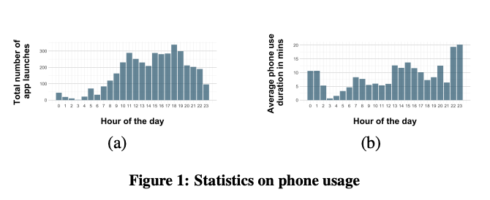
Notes:
Lets look at a couple of descriptive charts:
Picture 1:
The Figure A analyzed the count of application launches per hour of a day, and as we can see the number of application launches grows as the day progresses.
These results are inline with the Figure B where they visualized the average phone use duration per hour. And as you can see the highest average duration of phone usage occurs between 10pm and midnight while the lowest phone use occurs between 2:00 am and 7:00 am.

Slide 8
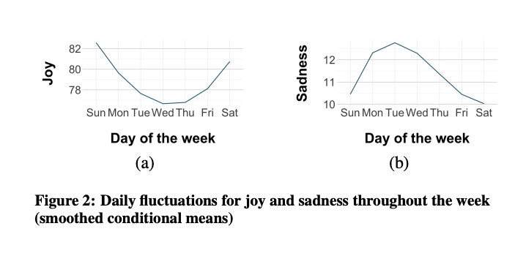
Notes:
Picture 2:
Researchers then analyzed the fluctuations of the participants emotion through the week. We can see that towards the weekend participants’ joy increases, while on weekdays it drops; whereas sadness drops towards the weekend and is at its peak on weekdays.

Slide 9
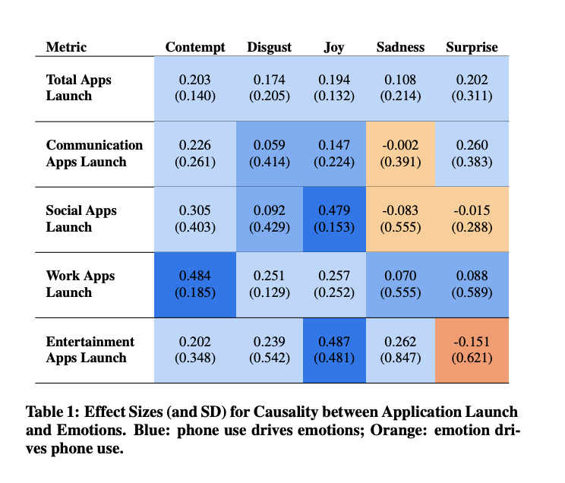
Notes:
Picture 3:
This table Shows the bidirectional causal relationship between the type of app launches and emotional state of the user to see if application launches lead participants to experience certain emotions, or vice-versa. Here we can see that sadness makes individuals to turn to social and communication apps. Whereas usage of work apps are leading to emotions of contempt.

Slide 10
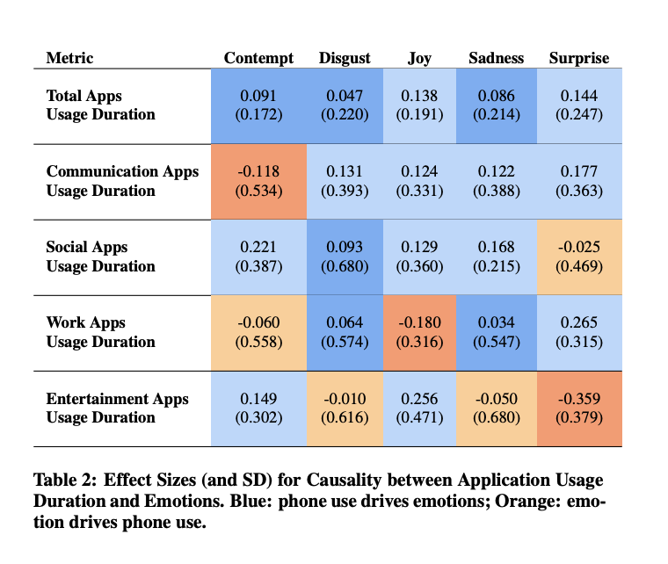
Notes:
In Picture 4:
This table shows the causal relationship between emotions and duration of different application categories. For eg. contempt drives use of communication apps for most participants as well as in some cases the emotion of joy drove them to the usage of work related apps.

Slide 11
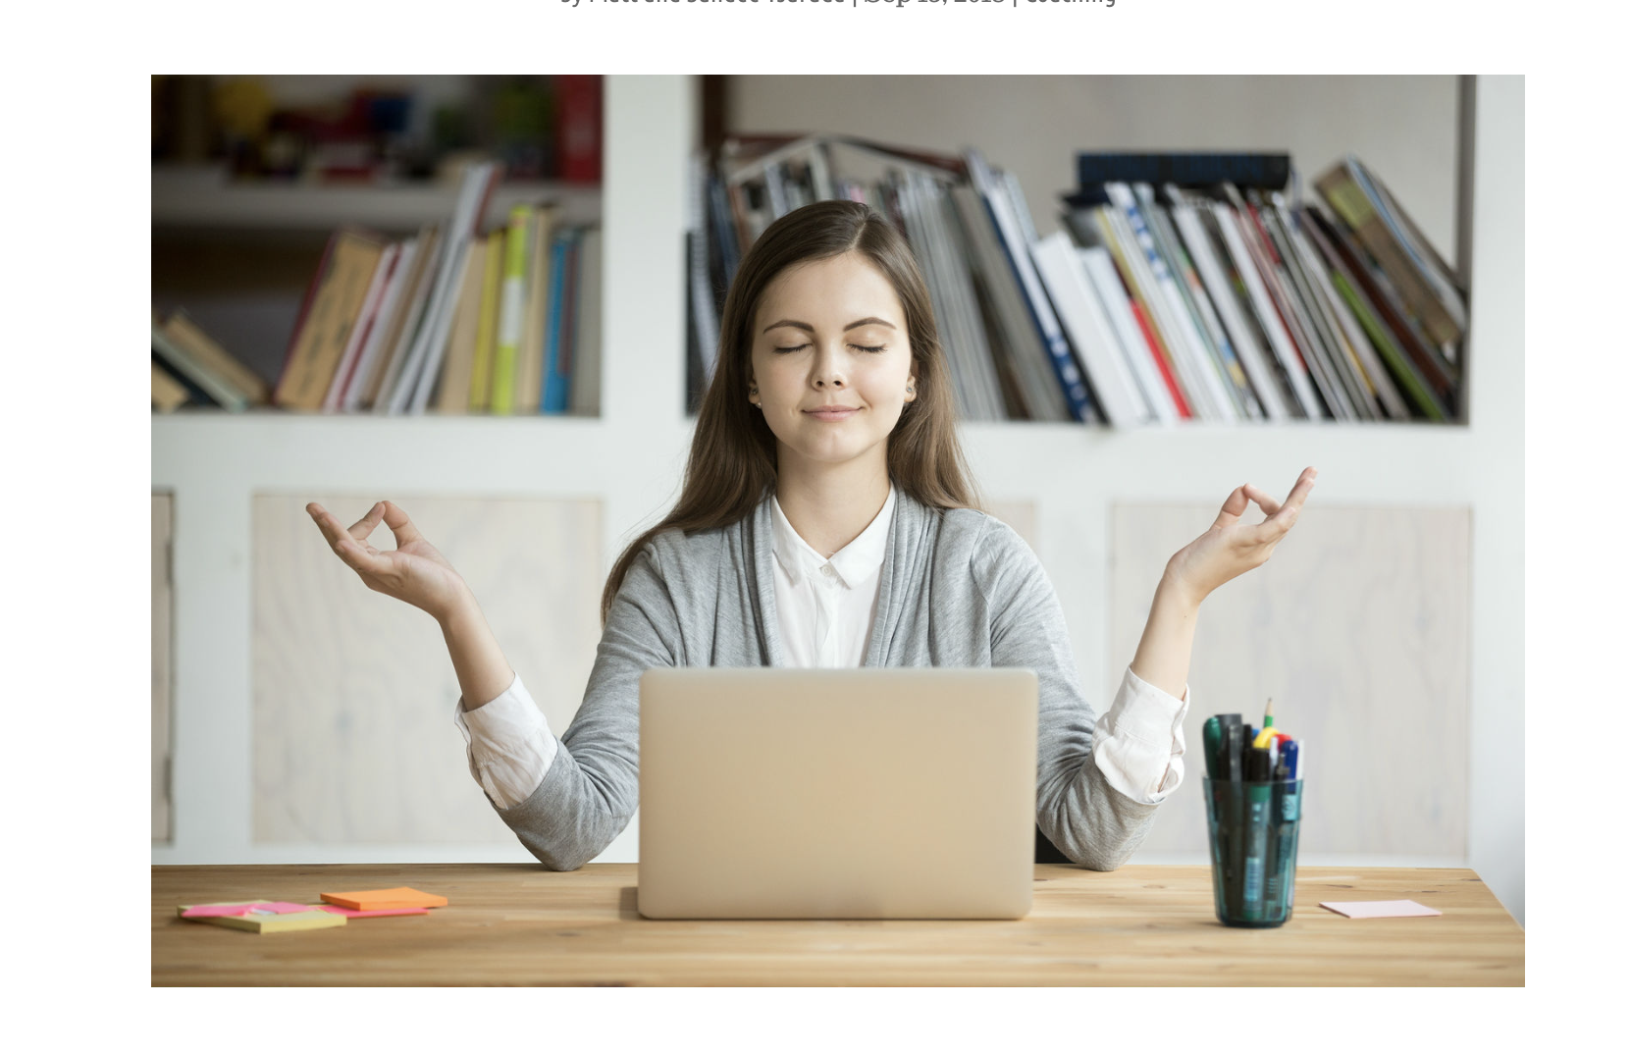
Coping Strategies
Digital mindfulness
Balancing online and offline activities
Mindfulness meditation
Notes:
https://greatergood.berkeley.edu/article/item/four_ways_technology_can_make_you_happier
Having dvelved into the potential negative impacts of technology, including its use as a emotion regulator, let's now explore coping strategies while using technology.
1)Digital mindfulness: This involves setting boundaries for screen time, taking regular breaks from digital devices, and cultivating a mindful approach to online activities
2) Balancing online and outdoor activites: Prioritizing face-to-face interactions and engaging in offline hobbies contribute to meaningful connections and personal well-being,
3) Mindfulness Meditation.
Mindful meditation has been shown to be effective in reducing stress by promoting relaxation and helping individuals develop a healthier response to stressors.

Slide 12
Conclusion
Use Information Technology as tool
Be aware of your technology use
Follow the coping strategies
Notes:
In Conclusion:
1)Recognize technology as a tool that can enhance your life rather than dominate it. Employ it purposefully to achieve specific goals
2) Cultivate self-awareness regarding your technology habits. Regularly assess digital device usage, online activities, and emotional impact for self-awareness, empowering conscious choices in technology engagement.
3) Lastly follow the coping strategies that we discussed

Slide 13
References
https://www.jorgegoncalves.com/docs/chi20b.pdf
https://dakotafamilyservices.org/resources/blog/archive/moods-feelings-emotions/#:~:
https://www.pewresearch.org/internet/2021/09/01/the-internet-and-the-pandemic/
https://www.forbes.com/sites/andrealoubier/2021/06/01/is-society-moving-in-the-right-direction-with-technology-rapidly-taking-over-the-world/?sh=376107a77c09
https://www.businessnewsdaily.com/4718-weekly-online-social-media-time.html
https://mydoctor.kaiserpermanente.org/mas/news/technostress-how-too-much-technology-effects-mental-health-2054999
https://www.medicalnewstoday.com/articles/negative-effects-of-technology#summary
https://greatergood.berkeley.edu/article/item/four_ways_technology_can_make_you_happier

Slide 14

Thank You! ☺

